Slide 1
Database Systems

Slide 2
Course Text Books
There are now various good textbooks for database systems, and those listed below are just few among many. Feel free to use other books in your possession if you don’t have those listed here.
.Database Management Systems by Connolly and Begg.
Fundamentals of database systems by Ramez Elmasri, Shamkant B Navathe .

Slide 3
Course Outline
-Introduction to Databases.
- The Database Environment. ( Ansi Sparc Architecure).
-Relational Model ( Design of the database)
-Data Modelling using Entity -Relationship model
- Relational Algebra
-Introduction to SQL.
-Use of SQL statements ( Creating a database , manipulation ( insertion, updating, deletion )

Slide 4
Chapter 1
Introduction to Databases

Slide 5
Chapter 1 Objectives
Some common uses of database systems.
Characteristics of file-based systems.
Problems with file-based approach.
Meaning of the term database.
Meaning of the term Database Management System (DBMS).
Typical functions of a DBMS.
Major components of the DBMS environment.
Personnel involved in the DBMS environment.
Advantages and disadvantages of DBMS’s.

Slide 6
Database
Defined as:
Shared collection of logically related data (and a description of this data), designed to meet the information needs of an organization.
accessed and manipulation by one or more users.
Logically related data comprises entities, attributes, and relationships of an organization's information.

Slide 7
DBMS
A software system that enables users to define, create, maintain, and control access to the database.
EXAMPLES ???
Oracle 9i /10g/11g
MS Access.
SQL server.
DB2.
MySQL

Slide 8
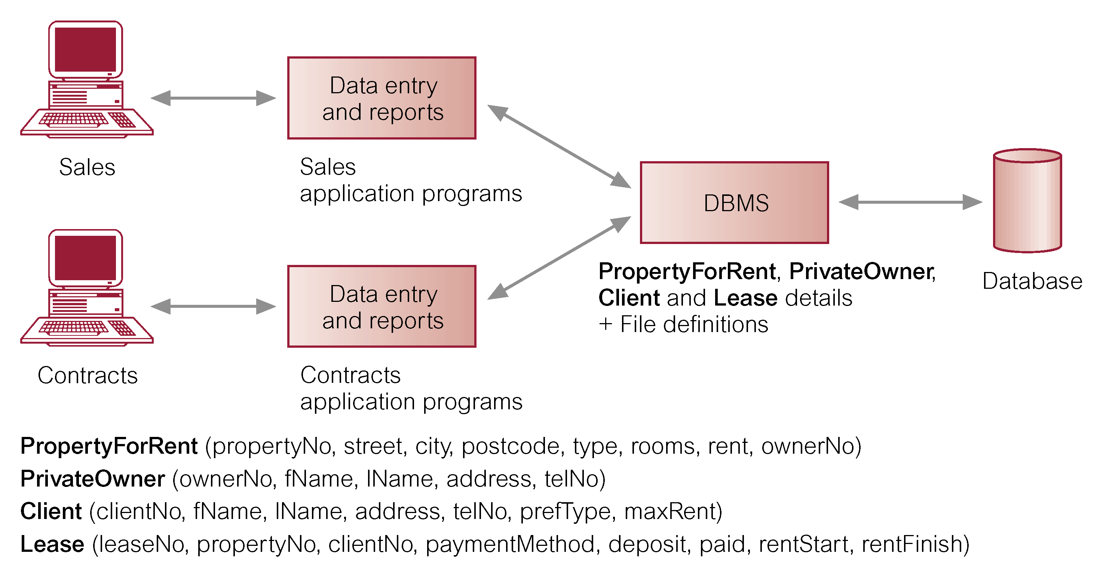
DATABASE

Slide 9
Examples of Database Applications
Purchases from the supermarket;
  A bar code reader scans each purchase.
  An application program then uses the barcode to find the price of the item from the product database.
  Program reduces number of items in stock and displays the price on the cash register.
Bank withdraws with an ATM card;
  There is need to check if there is enough credit on a card by a card reader linked to a computer.
  A database keeps track of all the transactions you make using the ATM card.
  Before a transaction is made a program checks if the card is not stolen or lost or forged and balance and purchase amount are compared.

Slide 10
More Examples of Database Applications
Using the local library;
  Database with details of books in the library
  An application can allow the user to find the book by title, author, subject area.
  System can allow reservations to be made and reminders sent to library users on when books are available or due.
  Communication
  Online shopping. e,.g Amazon.com keeps track of all purchases.
  Online studying. Content and Assessment of students have a database application running .
Booking a room for travel agents;
  The database system will ensure that 2 agents do not book the same holiday or over book the seats on flight

Slide 11
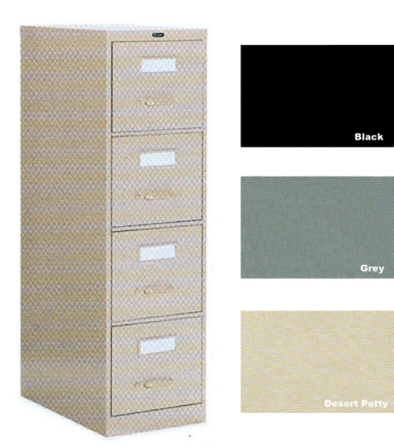
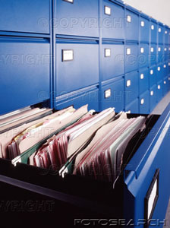
Manual Filing systems
  A manual file is set up to hold all external and internal correspondence about a given subject e.g. bills, project

Slide 12


Manual Filing Systems cont’d
  For easy storage, especially as numbers increase, labels are utilized.
  These files are kept in cabinets which are locked to ensure security.

Slide 13
Manual Filing system cont’d
It works well when the data or number of items to be stored is small.
Retrieval of data; is mainly sequential i.e. search begins from first entry or through an indexing system.
Limited processing of data i.e. answering complex queries that require data from different sources e.g. annual reports about sales was very difficult.
QUIZ: Any other challenges/Limitations of the manual filing system?

Slide 14
Computerised File-based Systems
A file is a collection of records which contain logically related data.
An early attempt to computerize the manual filing system
Collection of application programs that perform services for the end users.
It replaced manual system of logically arranging documents, labelling files and use of well locked cabinets.
Each program defines and manages its own data.

Slide 15
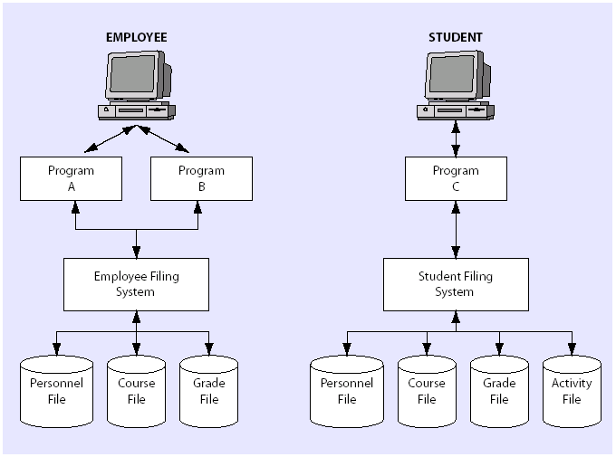
FILE-BASED APPROACH
A system of files and collection of application programs manipulating them is a file-based system
The University’s
File-Based System

Slide 16
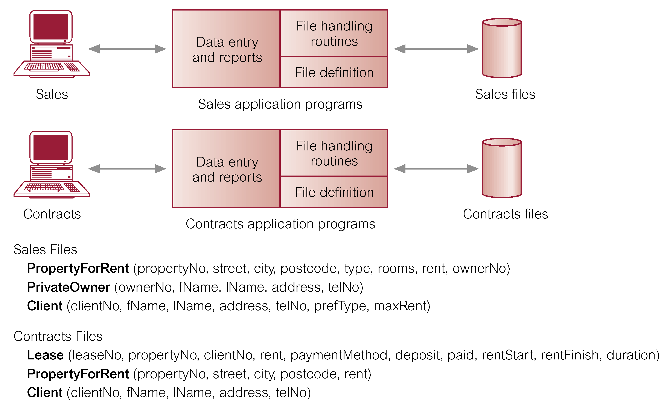
File-based Processing

Slide 17
Limitations of File-based Approach
Separation and isolation of data
  Each program maintains its own set of data.
  Users of one program may be unaware of potentially useful data held by other programs.
Duplication of data
  Same data is held by different programs.
  Wasted space and potentially different values and/or different formats for the same item.

Slide 18
Limitations of File-based Approach
Incompatible file formats
  Programs are written in different languages, and so cannot easily access each others files. This makes it difficult to process jointly.
Data dependence
-The Physical structure and storage of the data files are defined in the program code.
-Changes to an existing structure are difficult to make.

Slide 19
Types of databases
Traditional
Multimedia - pictures, video, sound
Scientific database
- GIS: maps, weather, satellite images
- biological database: DNA sequences
Real-time, active databases - industrial processes.
Real-time programs must execute within strict constraints on response time.By contrast, a non-real-time system is one for which there is no deadline, even if fast response or high performance is desired or preferred.

Slide 20
Database Approach
  AROSE Because
  -Definition of data was embedded in application programs, rather than being stored separately and independently.
  -No control over access and manipulation of data beyond that imposed by application programs.
  Therefore there was a need to separate data from programs but with a facility for them to interact.
Result
  : The database to store, organize and secure data and Database Management System (DBMS)

Slide 21
Why Databases are important
Data > Information > Knowledge.
Efficient Manipulation of large data sets.
Integration of Multiple Data Sources

Slide 22
Characteristics of the Database approach
Single depository of data
  sharable by multiple users, hence favorable for concurrency control
Self-describing - system catalogue contains metadata (data defining other data). Catalogue contain information about the definitions of the database objects (for example, tables, views)and security information about the type of access that users have to these objects.

Slide 23
Characteristics of the Database approach
  Multiple views of data - to support individual needs of users.
Program-data independence
  Data independence is a form of database management that keeps data separated from all programs that make use of the data. Data independence ensures that the data cannot be redefined or reorganized by any of the programs that make use of the data. In this approach, the data remains accessible, but is also stable and cannot be corrupted by the applications using it.
  It refers to the immunity of user applications to make changes in the definition and organization of data

Slide 24
Database Management System (DBMS)
A software system that enables users to define, create, and maintain the database and which provides controlled access to this database.
Users

Slide 25
Types of D/B Management System
The number of users determines whether the DBMS is classified as single-use or multi-user.
A Single –User DBMS supports only one user at a time. In otherwards if a user A is using the database, users B and C must await.
Multi-user DBMS: supports multiple users at the same time . The entire organization and supports many users across many departments.
QN : Give examples of single_user and multi_user DBMS?

Slide 26
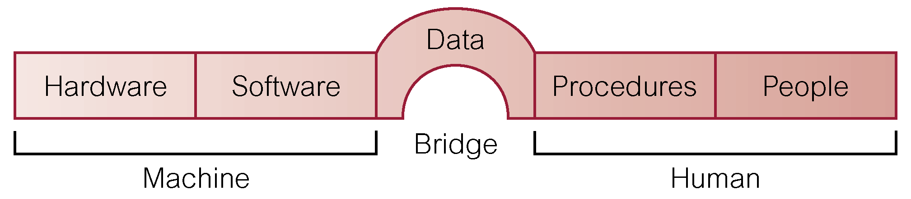
Components of DBMS Environment

Slide 27
Components of DBMS Environment.
  Hardware: refers to the physical parts of a computer and related devices. Can range from a PC to a network devices of computers.
Software: collection of programs used by the computers within the database system. DBMS, operating system, network software.

Slide 28
Components of DBMS Environment
Procedures
  Instructions and rules that should be applied to the design and use of the database and DBMS. These may consist instructions on how to:
  -Log onto the DBMS, Start and Stop DBMS, make backup copies
People
-Users of the database system.
- Includes database designers, DBAs, application programmers, and end-users.
Data: Data acts the bridge between the machine and human components. The database contains both operational and meta data .

Slide 29
Roles/Users in the Database Environment
Database Administrator (DBA) also known as DBA’s Responsible for the management and control of the database. More technically oriented than the DA
Database administrator's duties include:
  Granting user authority to access the database.
  Specifying integrity constraints.
  Monitoring performance and responding to changes in requirements.
  Data Administrator is responsible for database planning , development and maintenance of standards, policies and the conceptual design of the database.

Slide 30
Roles/Users in the Database Environment
Database Designers ( Logical and Physical)
Logical database designer is concerned with identifying data ( the attributes, entities, relationships between the data).
Physical database designer : designing any security measures required on the data. Selecting specific storage structures,(Swap-space management) and access methods for data to achieve good.

Slide 31
Roles/ Users in the Database Environment
Application Programmers. This category of people take care of writing programs for accessing the database. interact with system through DML calls. This includes how to retrieve data, update and delete data.
End Users (naive and sophisticated). Entry of data and manipulation of this data is taken care of by the end user. They do not know any thing about the database. E.g. checkout assistant at a local supermarket .

Slide 32
Functions of a DBMS
  Data Storage, Retrieval, and Update.
  Authorization Services: A User-Accessible Catalog.( rights of the user, database tables)
  Transaction Support
  Concurrency Control Services.
  Recovery Services.
  Support for Data Communication.
  Integrity/reliable Services.( maintain something thing in its truth or originality)
  Services to Promote Data Independence.

Slide 33
Advantages of DBMS
Control of data redundancy; As we discussed TFBS wastes space by storing the same information in more than one file. DBMS help in integrating files and avoiding multiple copies of the same data.
  Redundancy is not eliminated completely because of performance reasons.
Improved Security. If data is always accessed through the DBMS. The DBMS can enforce integrity constraints. Eg before inserting salary information for an employee, the DBMS can check that the dept budget is not exceeded.

Slide 34
Cont’d
Increased concurrency; In some file-based systems, if two or more users are allowed to access the same file simultaneously, the accesses may interfere with one another. With DBMS two or more users can access data at the same time without loss of data integrity.
Improved data accessibility and responsiveness; data crosses departments and unplanned questions can be asked unlike fixed queries in file based systems.
Improved backup and recovery services; DBMS provides facilities of minimizing amount of processing that is lost following a failure.

Slide 35
Sharing of data. Typically files are owned by the departments that use them . On the other hand the database belongs to the entire organization and can be shared by all authorized users.

Slide 36
Disadvantages of DBMS
Complexity; It has several components which need serious and careful planning to get a good DBMS.
Size; large size of software taking large disk space and memory.
Cost of DBMS. This varies with the number of users 1 or 50
Additional hardware costs; e.g. storage, memory etc
Cost of conversion; costs of converting existing applications to run on the new DBMS and hardware, employing specialists, training staff etc.
Performance; some applications may not run as first as the used to because DBMS caters for several applications at once.
Higher impact of a failure; integration of resources increases vulnerability.

Slide 37
Characteristics of relational table
A table/ relation is perceived as two-dimensional structure composed of rows and columns.
Each table row (Tuple) represents a single entity occurrence within an entity set.
Each table column represents an attribute and each column has a distinct name.

Slide 38
Properties of Relations/ Tables
Table name is distinct from all other table names in the database.
Each column has a distinct name.
Values of a column are all from the same domain.
All values in a column must conform to the data format . For example if the attributes is assigned an integer data format. All values in that column must be integers.
Order of columns has no significance.
Order of records has no significance.

Slide 39
Entities , Attributes
An Entity. Is a person, place or thing about which data are to be collected and stored.
An entity is described using a set of attributes . All entities have the similar/ related attributes.
Relationship : This is an association among two or more entities.
Eg . An employee Works in Department
Employee( ssn,name,lot)
Department( Dept Id, dname, budget )

